Slide 1


By MEDHINENI AMULYA – 99220041832
M SOWMYA – 99220041838
B.MANIKANTA – 99220041819
A.PRASHANTH KUMAR - 99220042062
Guided by: MRs.K.BAVANI KANNAN

Slide 2


Problem Statement
To Design and Develop a Deep Learning algorithm to classify the video as deepfake or pristine.

Slide 3
Introduction
Training Workflow
01
06
Prediction Workflow
System Architecture
07
02
Dataset Exploration
Tools and Technologies
03
08
Pre-processing
09
Results
04
Model Architecture
10
Demo
05

Slide 4
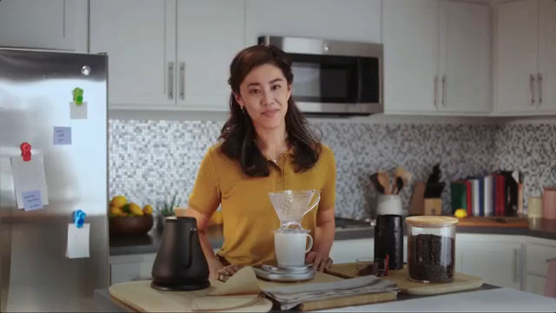
Introduction
Deep fake is a technique for human image synthesis based on artificial intelligence.
Deep fakes are created by combing and superimposing existing images and videos onto source images or videos using a deep learning technique known as generative adversarial network.

Slide 5
Can we detect Deep fakes with naked eyes?

Slide 6
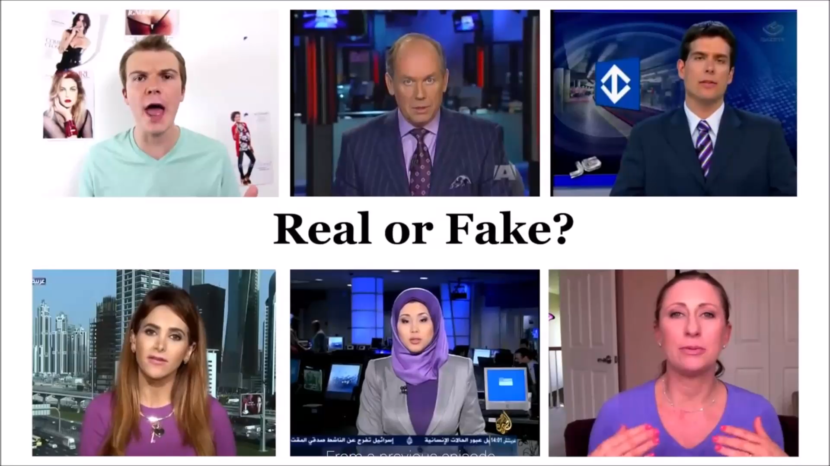

Slide 7
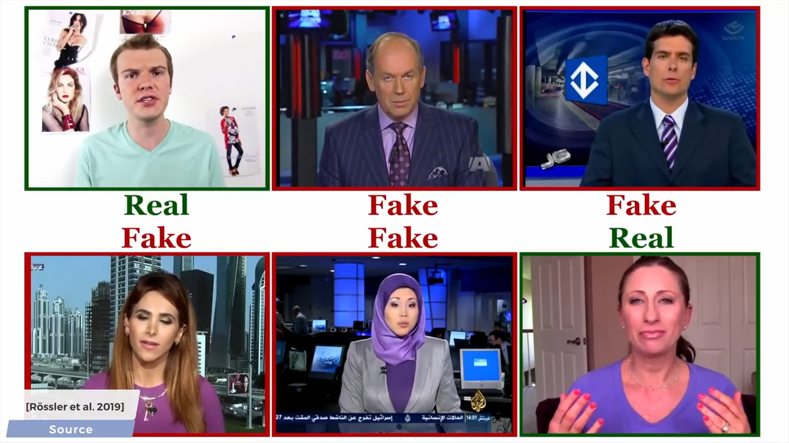

Slide 8
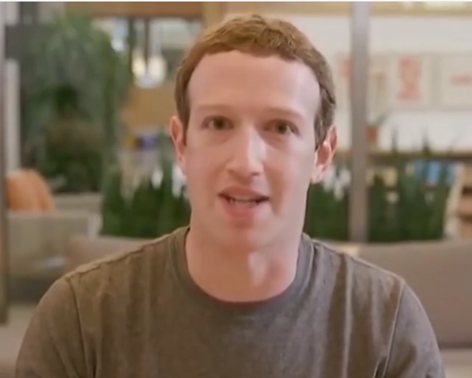
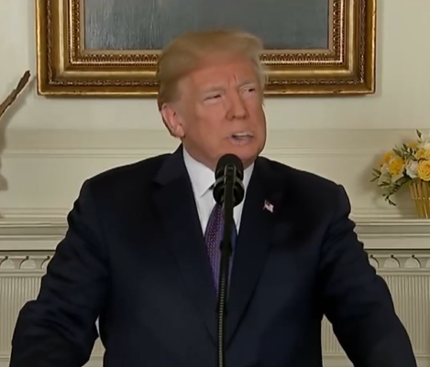
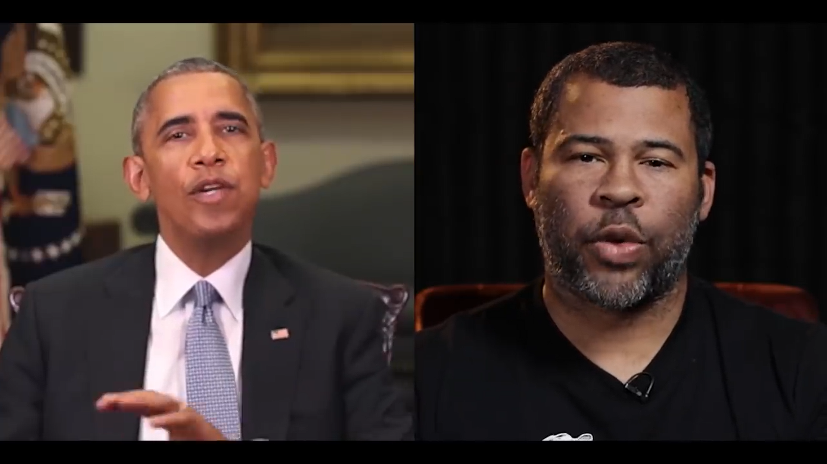
Why Deep Fake Detection ?
Fake News
Malicious hoaxes
Financial fraud
Celebrity unusual video
Revenge porn
Politician videos

Slide 9
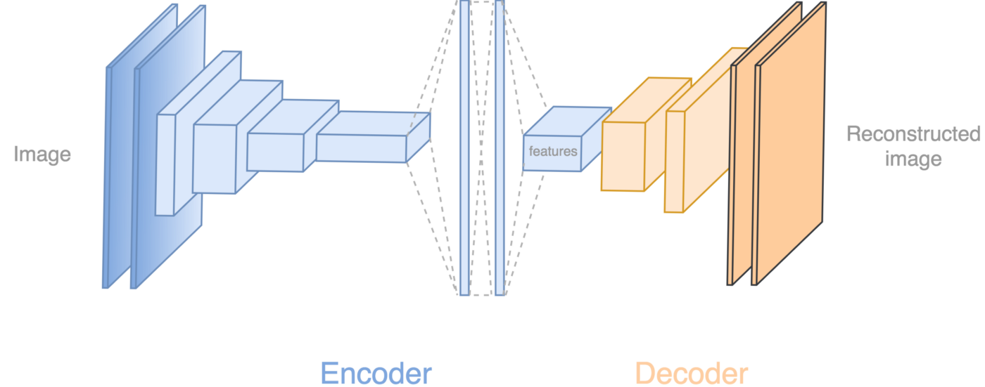
How Deep Fakes Are Created ?
Tools for deep fake creation.
Faceswap
Faceit
DeepFaceLab
DeepfakeCapsuleGAN
Large resolution facemasked

Slide 10
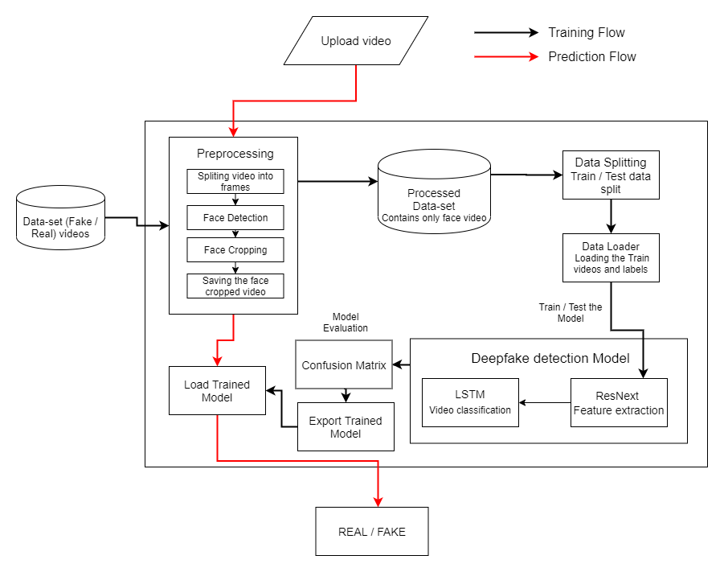

System Architecture

Slide 11
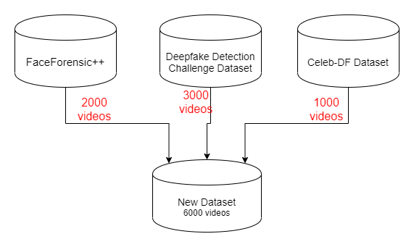

Data-set Exploration

Slide 12
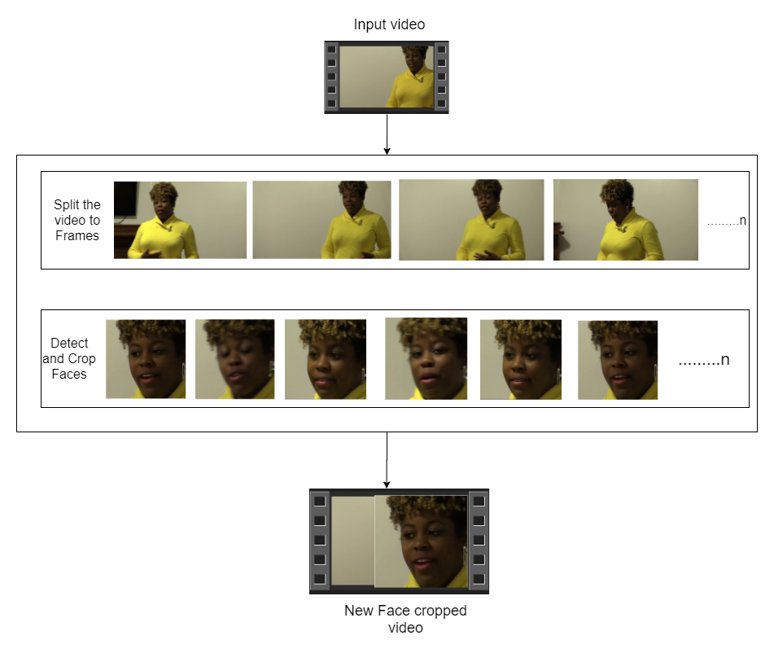

Pre-processing
SPLIT VIDEO INTO FRAMES
FACE DETECTION
5
4
3
2
1
CROPING FACE
CREATING NEW FACE CROPPED VIDEO
SAVING THE FACE CROPPED VIDEO

Slide 13
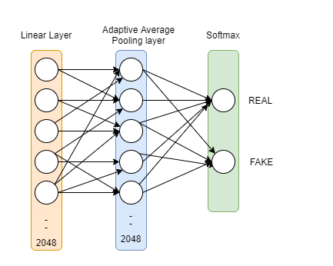
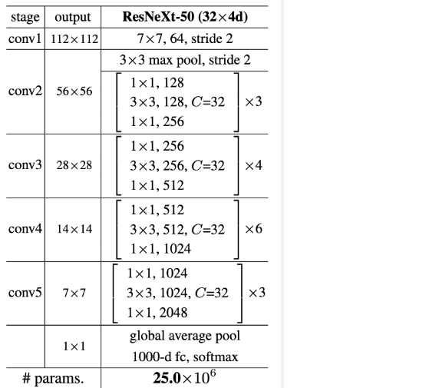

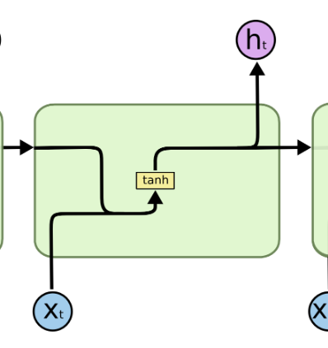
Model Architecture
ResNext-50
Sequential Layer
1 LSTM layer with 2048 shape input vector and 2048 latent features along with 0.4
chance of dropout and ReLU Activation function

Slide 14
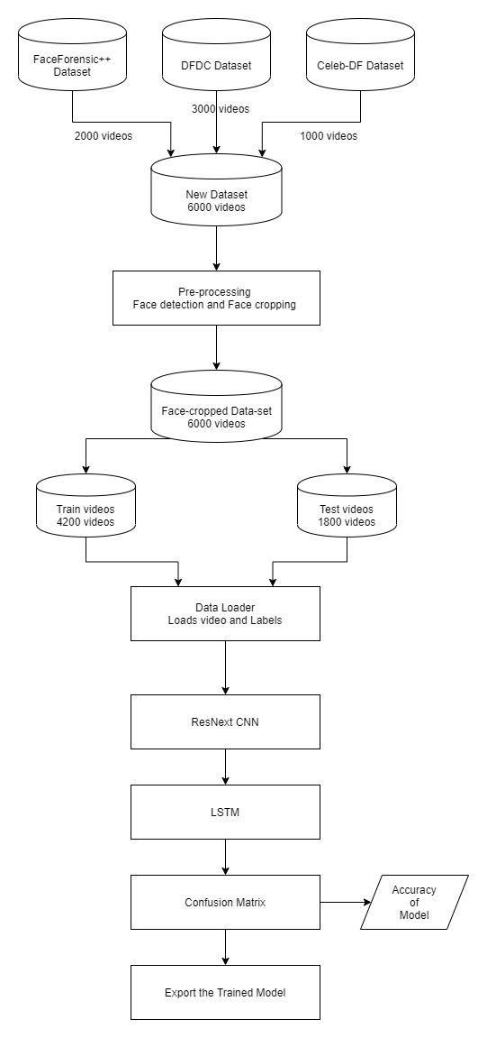
Training Workflow

Slide 15
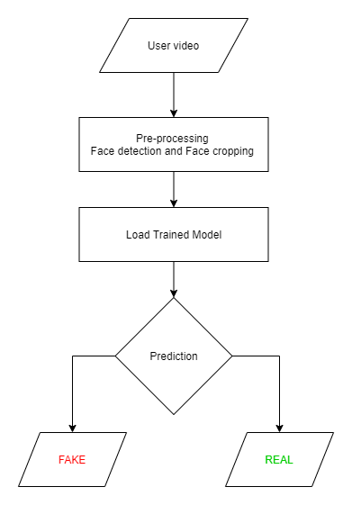
Prediction Workflow

Slide 16














Programming Languages
Python3
JavaScript
Programming Frameworks
PyTorch
Django
Tools and Technologies
IDE
Google
Jupyter Notebook
Visual Studio Code
Cloud Services
Google Cloud Platform
Version Control
Git

Slide 17


